Slide 1
Innovation Project Competition 2019 Briefing Session
HANG SENG UNIVERSITY OF HONG KONG
Date: Thursday, 04 October 2018
Time: 14:00 – 15:00

Slide 2
Innovation Project Competition 2019
The Innovation Project Competition is held by Centre for Teaching and Learning (CTL) of HSMC.
Aim: To promote a culture of innovation & creativity and enrich student learning experience at HSMC.
The submission should demonstrate the creative concepts, innovative design/modeling, as well as the applicability and impact.
The entry can be in the form of a conceptual model or a prototype.
Competition is organized in 3 areas:
Business Innovation
Social Innovation
Humanities Innovation

Slide 3
Who can apply?
All current HSMC students are eligible to participate.
Participants must form a project team with a most three students.

Slide 4
Awards
Award Certificates will be awarded to all selected teams
An entry in each group will be selected for the HSMC Project Competition Excellence Award – each team will receive Cash HK$5,000
At most five projects will be selected for HSMC Merit Award – each team will receive Cash HK$2,000
Awarded Teams will be recommended to participate in the pre-incubation programme organized by Wu Jieh Yee Centre for Innovation and Entrepreneurship.

Slide 5
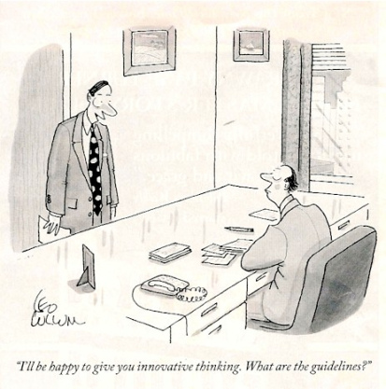
I’ll be happy to give you innovative thinking. What are the guidelines?

Slide 6
Area I - Business Innovation
Business Innovation
Business innovation refers to implementing new ideas, deriving more effective processes, creating better products and services that can enhance the competitive advantage to grow and success of a business. Innovation involves the process of translating ideas into goods or services that create values and satisfy the needs and expectations of the customers. Innovation can occur in a wide spectrum of business disciplines including accounting, banking and finance, management, marketing, information system, and logistics and supply chain management as well as interdisciplinary field in business.

Slide 7
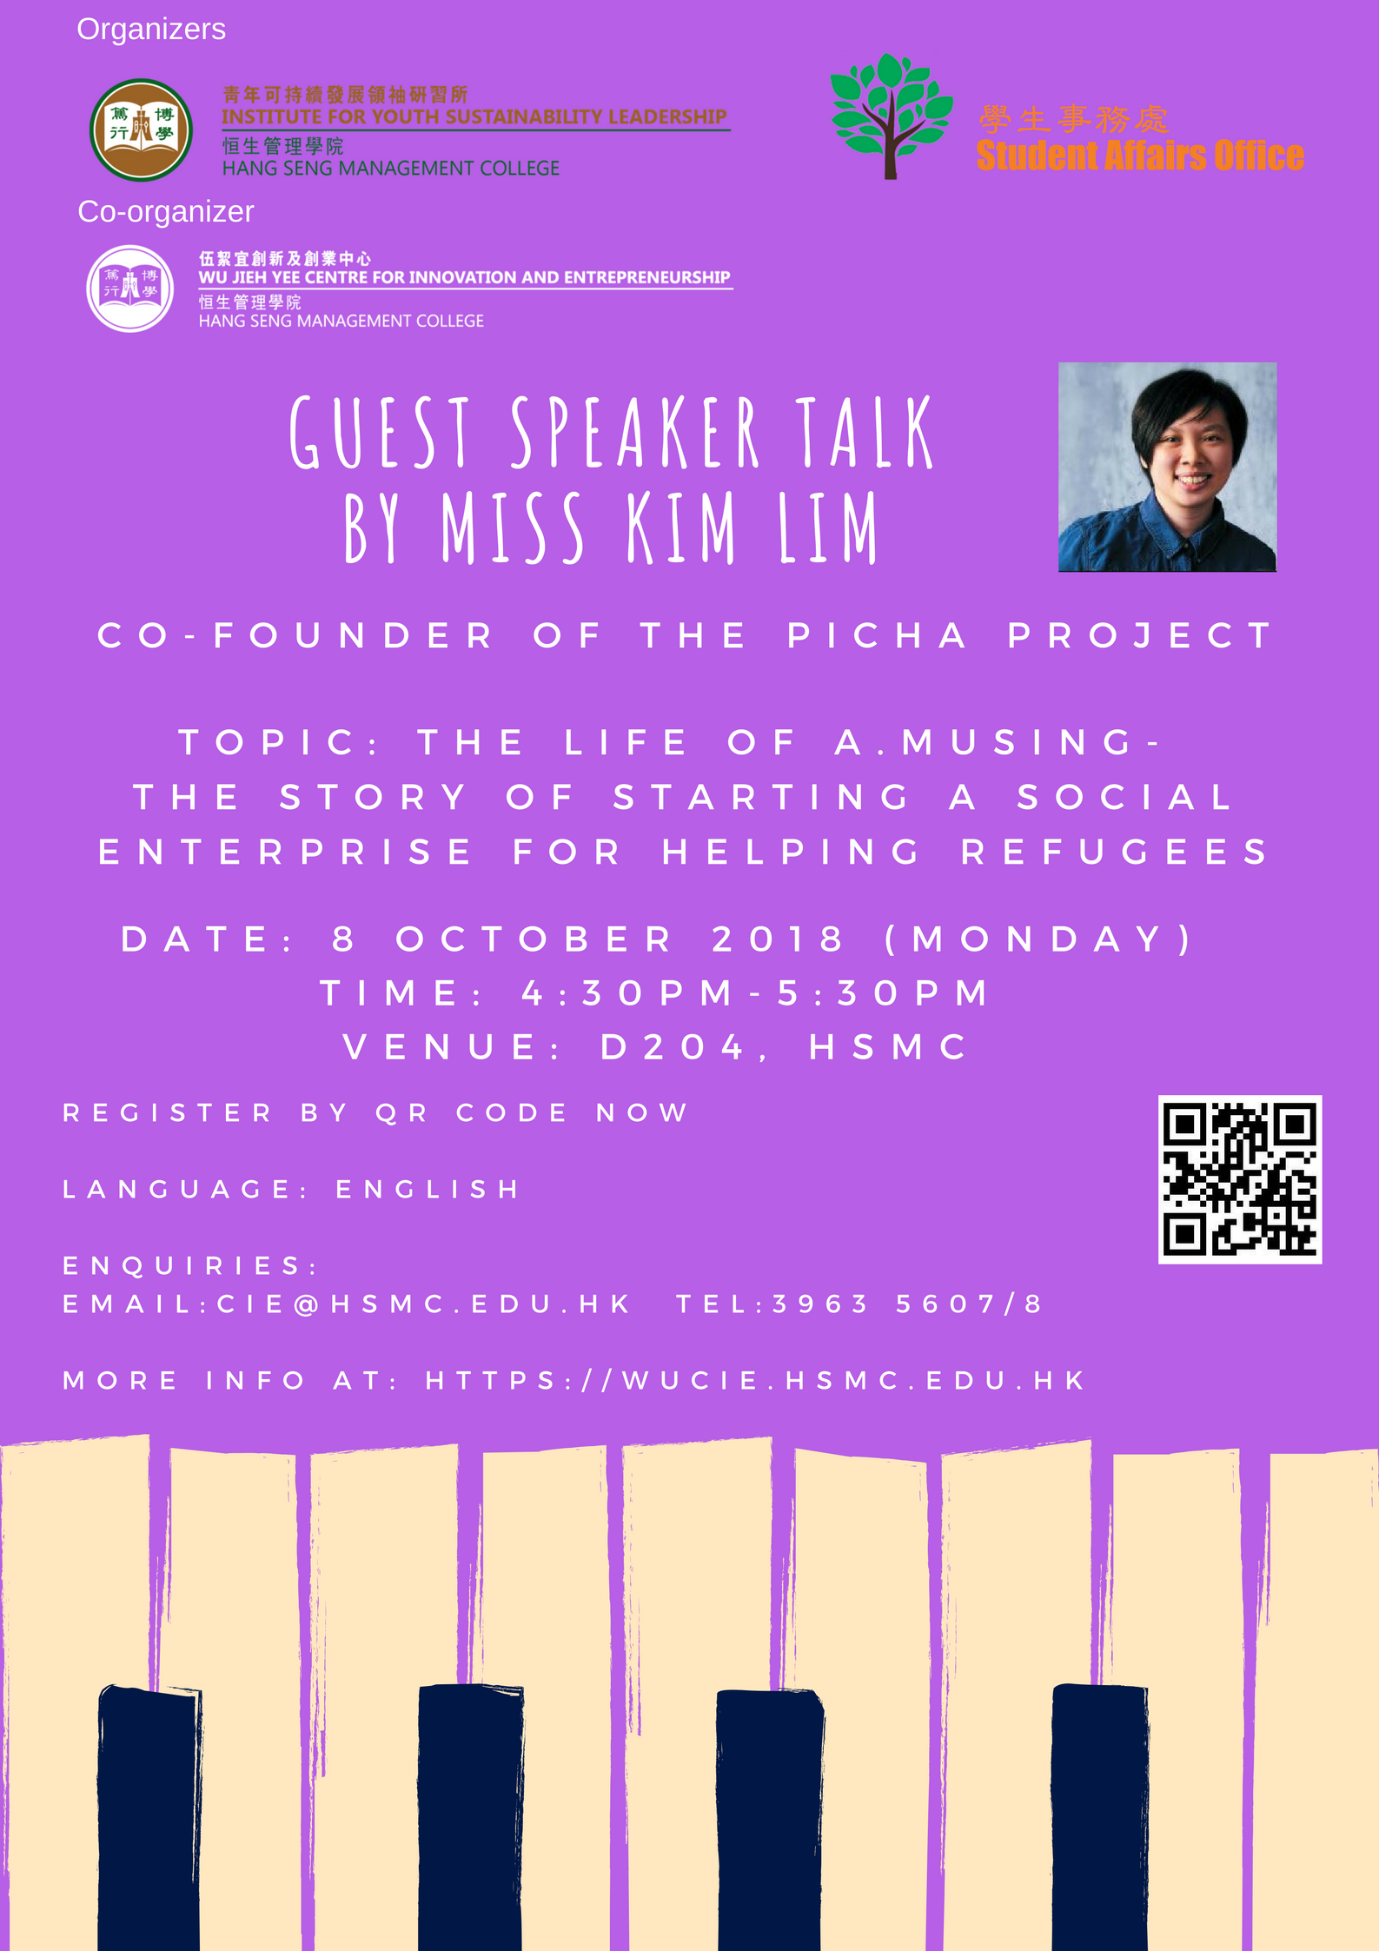
Area II - Social Innovation
Social Innovation
Social Innovation refers to the creation, development, adoption, and integration of new concepts and practices that address the changing social challenges. The social value created contributes the growth of communities and enhances their capacity to act. Innovation may be new ideas enhancing the understanding of human and society, such as political system, social relationship, social psychology, education, etc.

Slide 8
Area III - Humanities Innovation
Humanities Innovation
Humanities innovation is a new idea that contains the potential of its own realization in the form of cultural practices, intellectual movements, and forms of creative cooperation. The scope covers language, literature, art, philosophy, religion and some cross-categories such as photography, film or computer games. Innovation can be ideas reflect and enhance understanding of classics or constructing theory to understand important human value.

Slide 9
Selection Criteria
Selection Criteria:
Originality
Creativity
Innovativeness
Applicability
Impact

Slide 10
Important Notes
Submission Deadline: Monday, 31 December , 2018
Result Notification: On the day of Award Ceremony
Shortlisted project teams may be invited to give a presentation
All project teams are required to participate in a public poster presentation on the day of Award Ceremony
Award Ceremony will be held in February 2019 (to be confirmed)

Slide 11
Enquiries
For details please visit CTL Website at http://ctl.hsmc.edu.hk/en/innovation-project-competition/601b740eabce2aef843e3%20985a93f39b7c7bF or any enquiries please contact us at ctl@hsmc.edu.hk or contact Mr William Yieu at williamyieu@hsmc.edu.hk

Slide 12
Thank You
Any questions?

